Slide 1
Investigating Media Transparency
David Pfahler
Praktikum aus Visual Computing

Slide 2
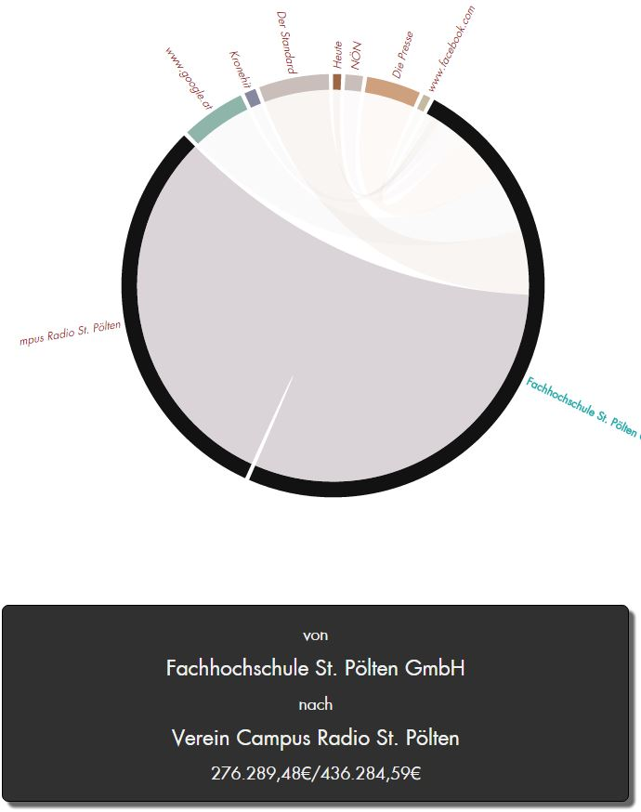
Overview
Motivation
Data
Related Work
Dashboard
Visualizations
Interactions
Evaluation

Slide 3
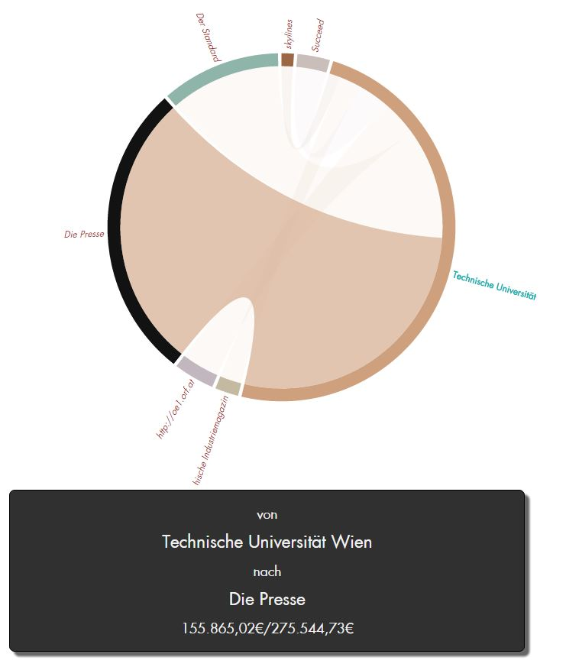
Motivation
Creating a visual analytics dashboard
Data Exploration
Data Wrangling

Slide 4
Data
Relations
Legal organizations
Media entities
Quarter
Sum
Legal Background

Slide 5
Data
14.5000 entries
1000 governmental
3000 media entities
Media | # | Sum
Kronen Zeitung | 1042 | 47.748.890,86€
KRONE | 15 | 2.524.123,07€
Kronehit | 172 | 2.223.498,63€
Krone bunt | 26 | 1.193.156,45€
Krone | 25 | 585.228,77€
www.krone.at | 49 | 524.306,82€

Slide 6
Overview
Motivation
Data
Related Work
Dashboard
Visualizations
Interactions
Evaluation

Slide 7
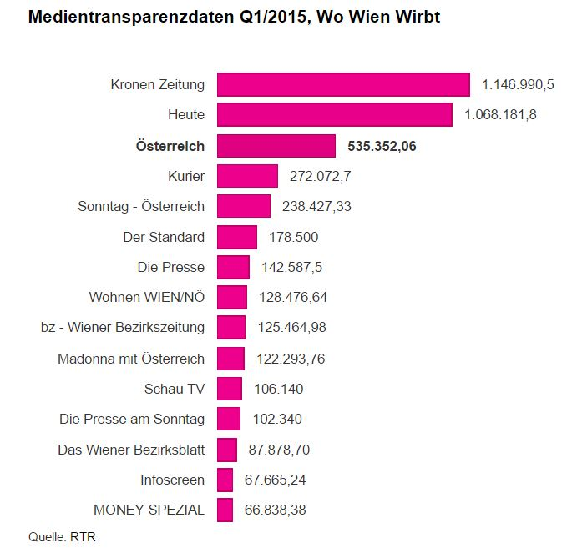
Related Work
[M. Hametner]
Not interactive Visualizations to present data
http://derstandard.at/2000017464403/Regierungsinserate-406-Millionen-im-ersten-Quartal

Slide 8
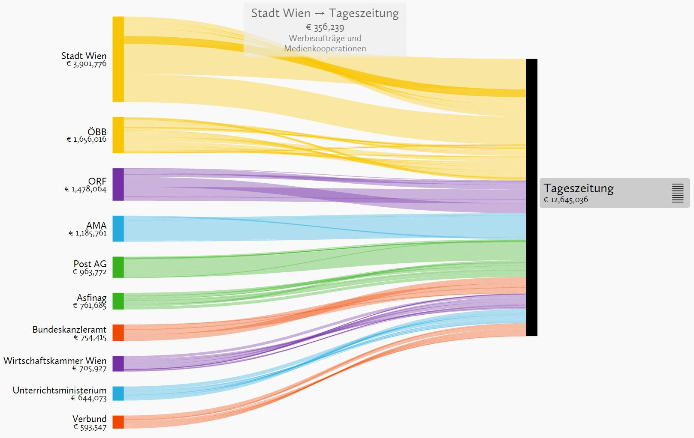
Related Work
[F. Lang]
Uses Grouping of the media entities
http://www.paroli-magazin.at/555/

Slide 9
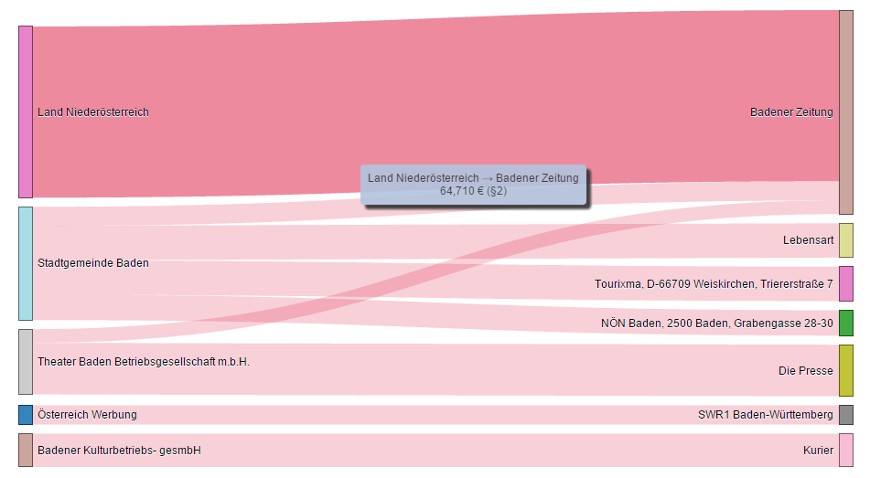
Related Work
[Salhofer, P.; Basyouni, A.; Stibler, M. & Vrecer, S]
Multiple not connected Visualizations
http://www.medien-transparenz.at/

Slide 10
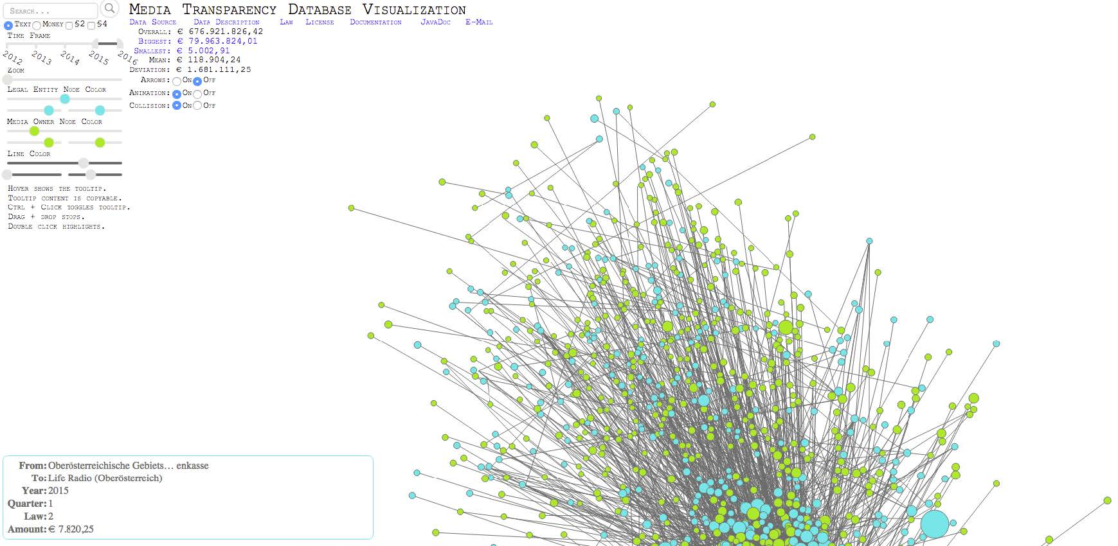
Related Work
[M. T. Schrempf]
Force directed node link diagram
(website down)

Slide 11
Overview
Motivation
Data
Related Work
Dashboard
Visualizations
Interactions
Evaluation

Slide 12
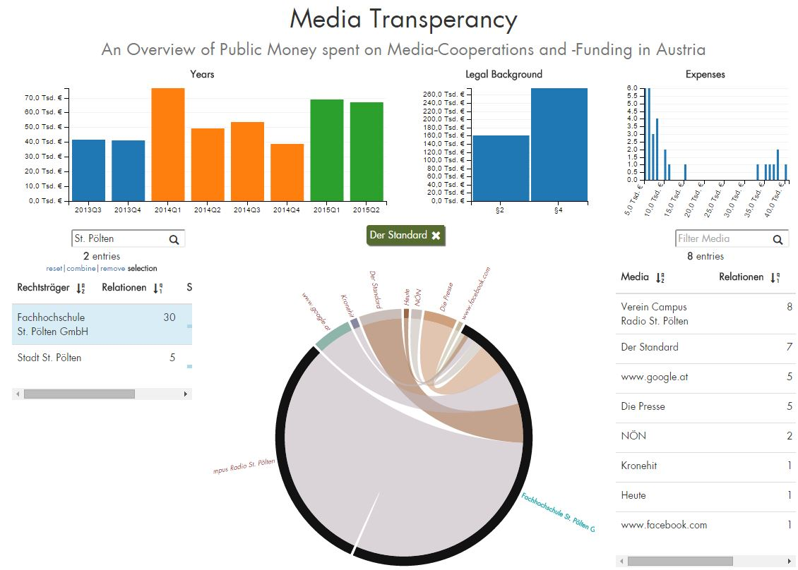
Dashboard – Interaction
DEMO

Slide 13
Overview
Motivation
Data
Related Work
Dashboard
Visualizations
Interactions
Evaluation

Slide 14
Dashboard – Evaluation
2 Informal Interviews
6 Questions …
In which quarter did the “WU Wien” spend most on advertisements? To whom?
…
Feedback on
Design
Interactions
Usability expert review with Supervisor

Slide 15
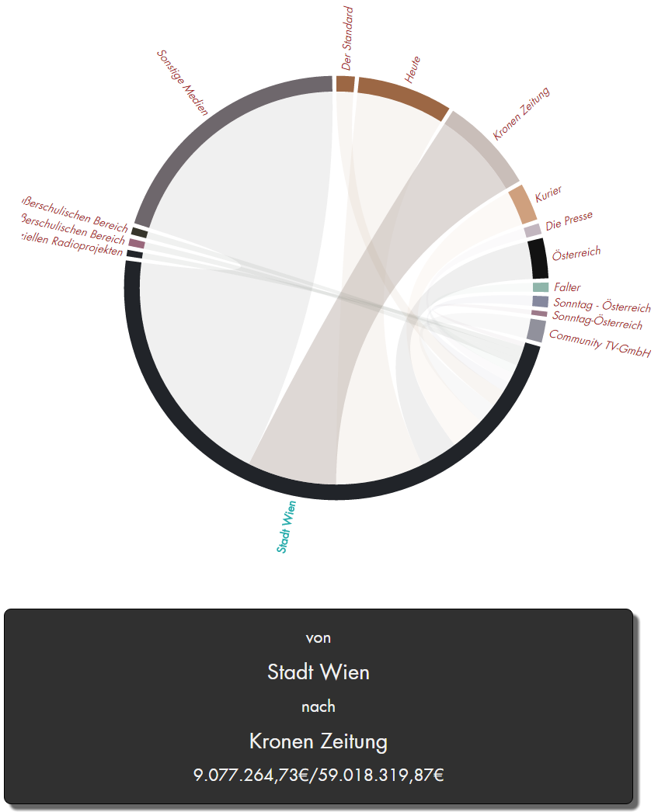
Investigating Media Transparency
Institute of Computer Graphics and Algorithms
Vienna University of Technology
David Pfahler

Slide 16
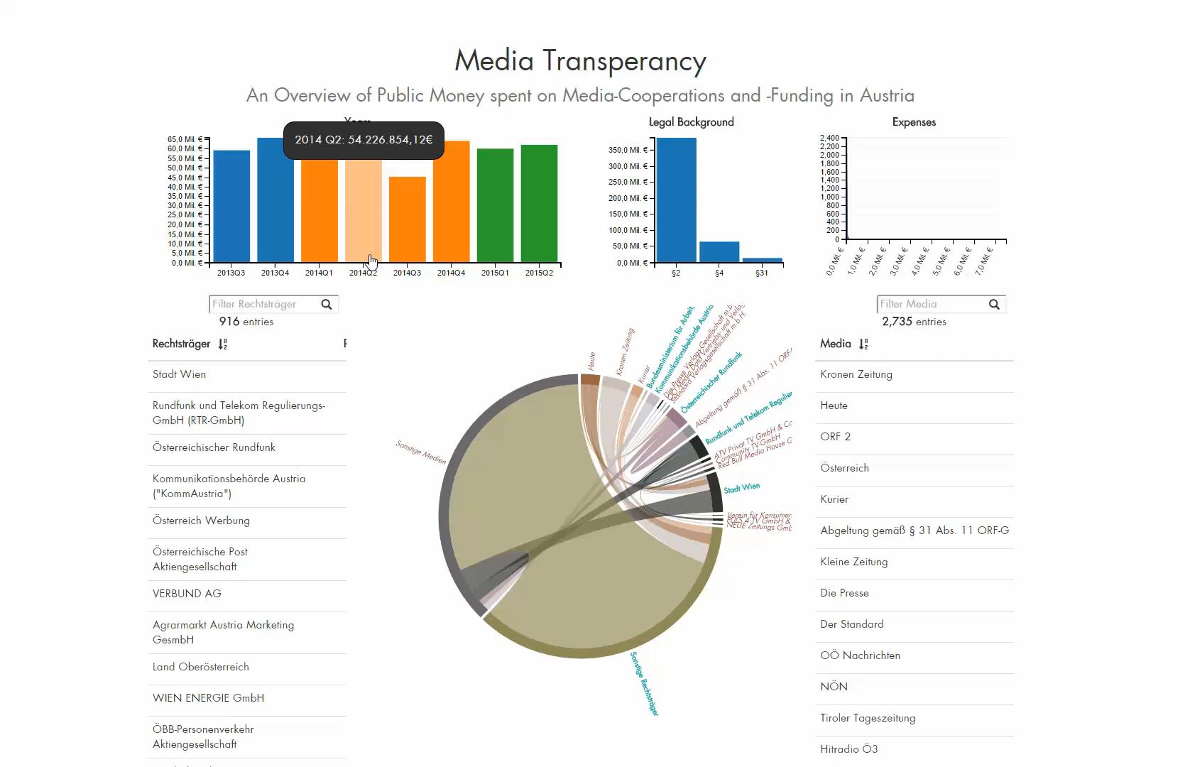
Demo

Slide 17

Dashboard

Slide 18
Dashboard - Visualizations

Slide 19
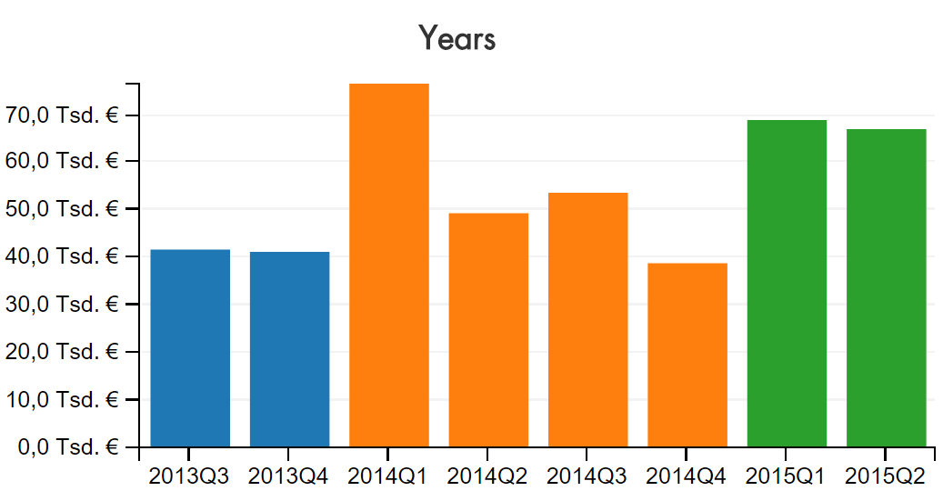
Dashboard - Visualizations

Slide 20
Dashboard - Visualizations

Slide 21
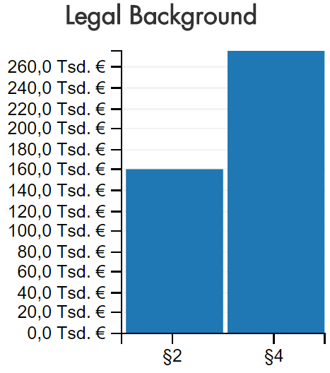
Dashboard - Visualizations

Slide 22
Dashboard - Visualizations

Slide 23
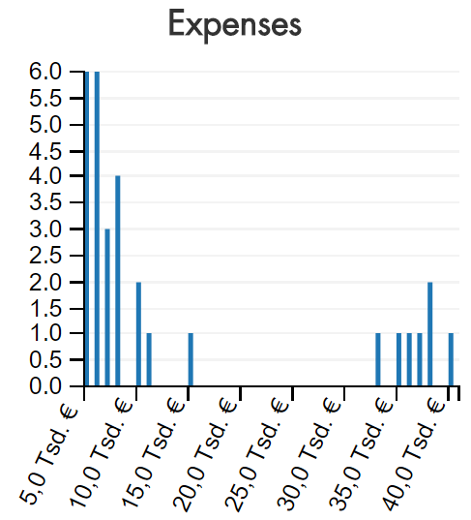
Dashboard - Visualizations

Slide 24
Dashboard - Visualizations

Slide 25
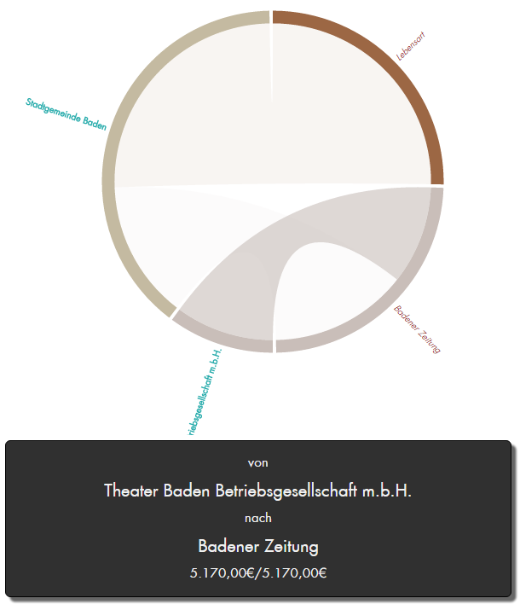
Dashboard - Visualizations

Slide 26
Dashboard - Visualizations

Slide 27
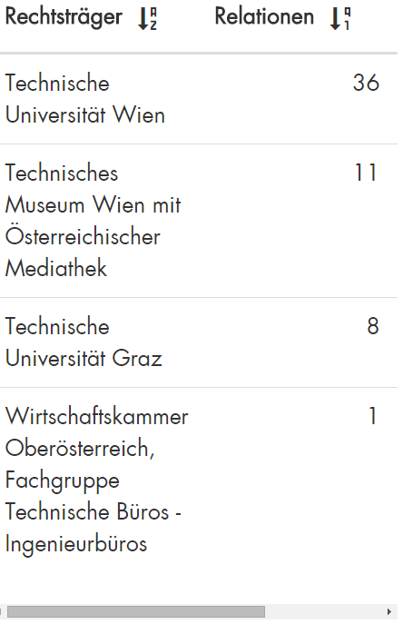
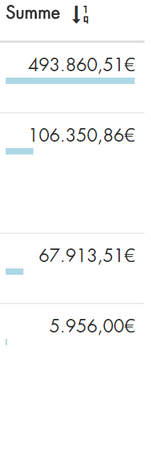
Dashboard – Visualizations

